Slide 1
Marketing Lecture # 8 Muhammad asad Instructor department of computer science

Slide 2
Key Learning Point :-
- Discussion about the market segmentation

Slide 3
WHAT IS MARKET SEGMENTATION?
The process by which --- Dividing a market of potential customers into smaller and more defined segments --- On the basis of certain common characteristics like demographics, interests, needs, or location.
The member of these groups share similar characteristics and usually have one or more than one aspect common among them --- Which makes it easier for the marketer to craft marketing communication messages for the entire group.

Slide 4
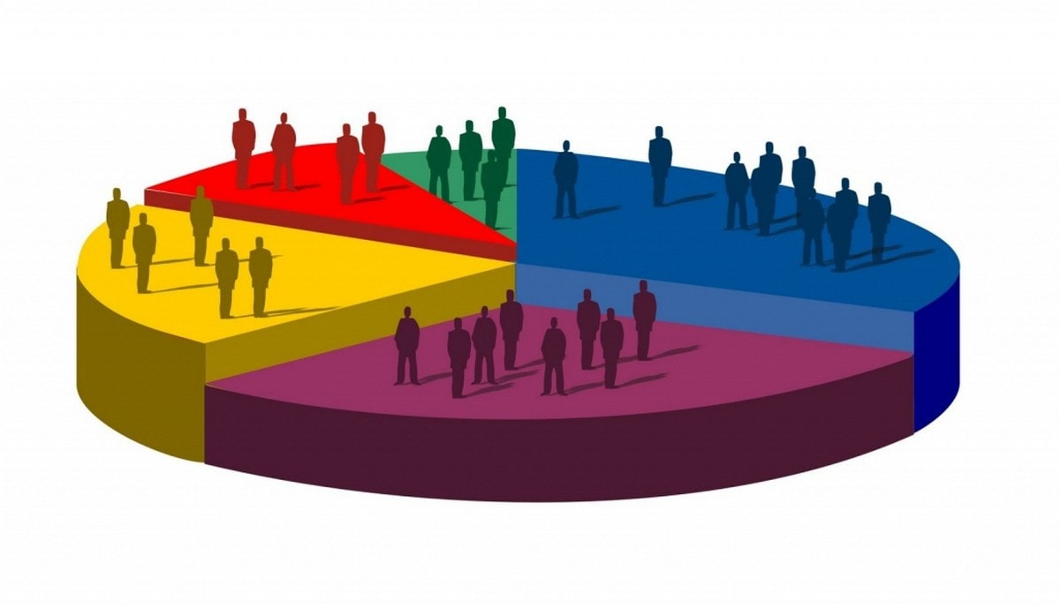
There are many reasons as to why market segmentation is done. One of the major reasons marketers segment market is because they can create a custom marketing mix for each segment and deliver them accordingly.

Slide 5
IMPORTANCE OF MARKET SEGMENTATION
Companies often deal with customers who belong to different age groups, have varied interests, and are motivated by different factors.
Segmenting these potential customers into different groups --- Makes it easier for the marketer to develop a different marketing mix for each customer segment which is more likely to bring results (Better resource utilization).
For example, a chips brand can launch a party pack for $15 in cities where teens are more likely to buy them for parties --- Whereas, the same brand may launch small packs in the country-side where people don’t spend a lot on chips.

Slide 6
GEOGRAPHIC SEGMENTATION
BEHAVIORAL SEGMENTATION
TYPES OF MARKET SEGMENTATION
DEMOGRAPHIC SEGMENTATION
PSYCHOGRAPHIC SEGMENTATION

Slide 7
GEOGRAPHIC SEGMENTATION
Divides the market on the basis of geography (Country, Region, City, Weather, Population density) --- This type of market segmentation is important for marketers as people belonging to different regions may have different requirements. (The needs of customers differ from region to region)
People belonging to different regions may have different reasons to use the same product as well --- Geographic segmentation helps marketer draft personalized marketing campaigns for everyone.

Slide 8
FOR EXAMPLE
Water might be scarce in some regions which increases the demand for bottled water --- But at the same time --- It might be in abundance in other regions where the demand for the same is very less.
Someone in a rural area wouldn’t need a Subway / McDonald --- But someone in a city would.
You can use this type of segmentation to adapt --- The language and tone of your messages.
In Georgia, every soda is called coke until you ask a few clarifying questions. In Chicago, soda is referred to as pop.

Slide 9
DEMOGRAPHIC SEGMENTATION
Divides the market on the basis of demographic variables (Age, Gender, Marital Status, Family Size, Income, Religion, Race, Occupation, Nationality, and etc.) --- This is one of the most common segmentation practice among marketers.
These are usually black and white groupings --- That give you a profile of whether or not someone has the ability to buy what you’re selling --- Like, If you have a product for people 21 and older (like cigarette) --- Then people under that age group (1 to 20) are irrelevant for you.

Slide 10
FOR EXAMPLE
THE TRAVEL INDUSTRY (Emirates – A380)
The way and the people who a first-class ticket is marketed to are different from a economy-class ticket.
It emphasize the comfort and luxury of first class tickets.
https://www.emirates.com/pk/english/experience/cabin-features/first-class/
https://www.youtube.com/watch?v=bSdzhCjFtNg
For economy class, they focus on legroom, the number of TV channels they have and etc.
https://www.emirates.com/pk/english/experience/cabin-features/economy-class/
https://www.youtube.com/watch?v=nStRXi9ix8A

Slide 11
BEHAVIORAL SEGMENTATION
The market is also segmented based on People Loyalty, usage, preference, choices, spending habits, purchasing habits, occasions, special events and etc. --- Because there are several factors which a consumer takes into consideration before taking a decision --- The segments are usually divided based on People knowledge of the product and usage of the product.
It is believed that the knowledge of the product and its use --- Affect the buying decision of an individual.

Slide 12
The People can be segmented into --- Those who know about the product --- Those who don’t know about the product --- Ex-users --- Current Users --- Potential users --- First time users and etc.
People can be segmented as brand loyal, brand-neutral, or competitor loyal --- People can also be segmented according to their usage.

Slide 13
FOR EXAMPLE
USAGE BASED (BEAUTY PARLORS or PERSONAL CARE)
The usage can be demonstrated in the form of heavy usage, moderate usage or lesser usage.
There are some customers who use a lot of personal care products whereas others do not use personal care products much --- Thus depending on their usage the customers can be segmented.
There are multiple sizes available of any beauty care item --- These multiple sizes are segmented towards the usage level of the customer --- Heavy usage customers can buy the large containers and medium or small users can buy the smaller container.

Slide 14
FOR EXAMPLE
PREFERENCE & CHOICES BASED
Several products are segmented towards the benefits sought by the customer.
Recently, there has been a market war between Colgate and Sensodyne to target the people who have sensitive teeth.
Similarly, there are other toothpastes which are segmented towards whitening of teeth.
Hair shampoos are segmented towards split ends, anti dandruff or others.

Slide 15
FOR EXAMPLE
OCCASIONS BASED
Products such as chocolates and premium foods will sell on festivals.
Similarly, confectioneries will sell when there is a party. Thus these products are generally targeted by behavioral segmentation.
Hotels and restaurants will target new year as they will have more customers over the new year which is a moment of outdoor celebration.

Slide 16
PSYCHOGRAPHIC SEGMENTATION
Divides the market on the basis of their personality, lifestyle, opinions and attitude --- Personality is the combination of characteristics that form an individual’s unique character includes habits, traits, attitude, temperament, etc. --- Lifestyle is how a person lives his life.
Psychographic segmentation is similar to behavioral segmentation but there’s a difference --- This is the type of segmentation that tells you --- What people do and why they buy.

Slide 17
FOR EXAMPLE
The world’s most famous phone brand Apple, is known to have phone products that easily cost over $600 --- Yet they have customers who purchase their phones even if they have a monthly income far below $600.
Looking at the demographic Segmentation alone will put marketers at a loss, leaving them to phenomenon what the reasons people are purchasing the phone way above their income level.

Slide 18
However, if psychological explanations are taken into picture, the action of consumers can be easily explained --- By wanting to be associated with high social status, a good sense of judgment, or being in the same social group.
Hence with Psychographic Segmentation, marketers can gain a better understanding of the Psychological factor behind the purchasing behavior --- and --- Fine-tune your marketing messages based on each.

Slide 19
EXAMPLES OF MARKET SEGMENTATION
BEAUTY PRODUCTS
Marketers often segment the target market according to the age of the users, the skin type, and also the occasion.
A perfect example of this is Olay --- The company developed its ‘Age Defying’ product range for mature adults --- and --- ‘Clearly Clean’ range for young adults and teens.

Slide 20
FAST FOOD
Fast food chains like McDonald’s often segment their target audience into kids and working adults and develop different marketing plans for both.
Marketing efforts like distributing a toy with every meal works well for kids ---and--- providing the food within 10 minutes, free WiFi, and unlimited refills work well for working adults.
SPORTS
Sports brands like Nike, Adidas, Reebok, and etc. often segment the market based on the sports they play --- Which help them market the sports-specific products to the right audience.

Slide 21

ANY QUESTION
You can contact me at: asadali@uosahiwal.edu.pk
Your query will be answered within one working day.

